Slide 1
Security Policy

Slide 2
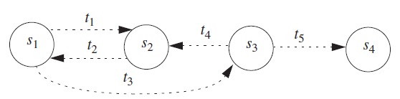
Security Policy
It defines “Secure” for a system or a set of systems.
It can be informal or highly mathematical in nature.
If we consider a computer system as finite state automaton then a security policy partitions the state of a system into a set of authorized/secure(s₁, s₂) and unauthorized/insecure states(s₃, s₄) with t_{i} transitions.
A secure system starts in an authorized state and cannot enter an unauthorized state.
A breach of security occurs when a system enters an unauthorized state.
If we remove the transition t₃ from s₁-s₃ then the system is secure.

Slide 3
Types of Security Policies
Information Flow Policies/Confidentiality policies.
Integrity Policies
Availability Policies

Slide 4
Information Flow Policies/Confidentiality policies.
This policy identifies those states in which information leaks to those not authorized to receive it.
This includes not only the leakage of rights but also the illicit transmission of information without leakage of rights, called information flow.
In addition, the policy must handle dynamic changes of authorization.
For example, a contractor working for a company may be authorized to access proprietary information during the lifetime of a nondisclosure agreement, but when that nondisclosure agreement expires, the contractor can no longer access that information.

Slide 5
Integrity policy
This security policy identifies authorized ways in which information may be altered and entities authorized to alter it.
Authorization may derive from a variety of relationships, and external influences may constrain it.
For example, in many transactions, a principle called separation of duties forbids an entity from completing the transaction on its own.

Slide 6
Availability Policies
This policy describes what services must be provided.
It may present parameters within which the services will be accessible.
For example, that a browser may download Web pages but not Java applets.
It may require a level of service
For example, that a server will provide authentication data within 1 minute of the request being made. This relates directly to issues of quality of service

Slide 7
Example
A university disallows cheating, which is defined to include copying another student’s homework assignment (with or without permission). A computer science class requires the students to do their homework on the department’s computer. One student notices that a second student has not read protected the file containing her homework and copies it.
Has either student (or have both students) breached security?
The second student has not, despite her failure to protect her homework. The security policy requires no action to prevent files from being read.
The first student has breached security.
The security policy disallows the copying of homework, and the student has done exactly that.

Slide 8
Security mechanism
A security mechanism is an entity or procedure that enforces some part of the security policy
EXAMPLE: In the preceding example, the policy is the statement that no student may copy another student’s homework. One mechanism is the file access controls; if the second student had set permissions to prevent the first student from reading the file containing her homework, the first student could not have copied that file

Slide 9
Security model
A model that represents a particular policy or set of policies.

Slide 10
Bell-LaPadula (BLP) Model
Security levels arranged in linear ordering
Top Secret: highest
Secret
Confidential
Unclassified: lowest
Levels consist of security clearance L(s)
Objects have security classification L(o)

Slide 11
Bell-LaPadula (BLP) Model
Developed in 1970s
Initially funded by US Department of Defense
Bell-LaPadula (BLP) model very influential
Formal model for access control
Subjects and objects are assigned a security class
Form a hierarchy and are referred to as security levels
A subject has a security clearance
An object has a security classification
Security classes control the manner by which a subject may access an object
Notes:
11
The BLP model was developed in the 1970s as a formal model for access control. The model relied on the access control concept described in Chapter 4 (e.g., Figure 4.4). In the model, each subject and each object is assigned a security class. In the simplest formulation, security classes form a strict hierarchy and are referred to as security levels. One example is the U.S. military classification scheme:
top secret > secret > confidential > unclassified
This concept is equally applicable in other areas, where information can be organized into gross categories and users can be granted clearances to access certain categories of data. For example, the highest level of security might be for strategic corporate planning documents and data, accessible by only corporate officers and their staff; next might come sensitive financial and personnel data, accessible only by administration personnel, corporate officers, and so on.
A subject is said to have a security clearance of a given level; an object is said to have a security classification of a given level. The security classes control the manner by which a subject may access an object. The model defined four access modes, although the authors pointed out that in specific implementation environments, a different set of modes might be used. The modes are: read, append, write, execute.

Slide 12
A BLP Example
Security level | Subject | Object
Top Secret | Tamara | Personnel Files
Secret | Samuel | E-Mail Files
Confidential | Claire | Activity Logs
Unclassified | James | Telephone Lists
Tamara can read all files
Claire cannot read Personnel or E-Mail Files
James can only read Telephone Lists
Slide #5-12

Slide 13
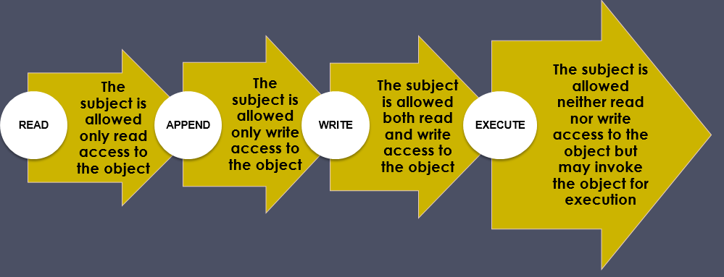
Access Privileges

Slide 14
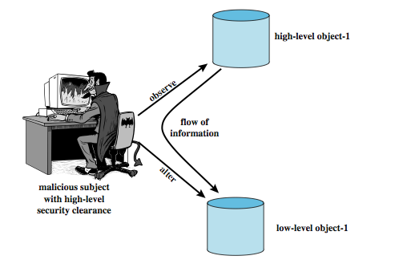
Multilevel Security
Multiple levels of security and data
Subject at a high level may not convey info to a subject at a non-comparable level:
No read up (ss-property): a subj can only read an obj of less or equal sec level
No write down (*-property): a subj can only write into an obj of greater or equal sec level
Notes:
14
The BLP model was developed in the 1970s as a formal model for access control. The model relied on the access control concept described in Chapter 4 (e.g., Figure 4.4). In the model, each subject and each object is assigned a security class. In the simplest formulation, security classes form a strict hierarchy and are referred to as security levels. One example is the U.S. military classification scheme:
top secret > secret > confidential > unclassified
This concept is equally applicable in other areas, where information can be organized into gross categories and users can be granted clearances to access certain categories of data. For example, the highest level of security might be for strategic corporate planning documents and data, accessible by only corporate officers and their staff; next might come sensitive financial and personnel data, accessible only by administration personnel, corporate officers, and so on.
A subject is said to have a security clearance of a given level; an object is said to have a security classification of a given level. The security classes control the manner by which a subject may access an object. The model defined four access modes, although the authors pointed out that in specific implementation environments, a different set of modes might be used. The modes are: read, append, write, execute.

Slide 15
BLP Operations
get access: add (subj, obj, access-mode) to b
used by a subj to initiate an access to an object
release access: remove (subj, obj, access-mode)
change object level
change current level
give access permission: Add an access mode to M
used by a subj to grant access to on an obj
rescind access permission: reverse of 5
create an object
delete a group of objects
Notes:
15
The BLP model includes a set of rules based on abstract operations that change the state of the system. Each rule is governed by the BLP three properties, and are:
1. Get access: Add a triple (subject, object, access-mode) to the current access set b. Used by a subject to initiate access to an object in the requested mode.
2. Release access: Remove a triple (subject, object, access-mode) from the current access set b. Used to release previously initiated access.
3. Change object level: Change the value of f_{o}(O_{j}) for some object O_{j}. Used by a subject to alter the security level of an object.
4. Change current level: Change the value of f_{c}(S_{i}) for some subject S_{i}. Used by a subject to alter the security level of a subject.
5. Give access permission: Add access mode to some entry of the access permission matrix M. Used by a subject to grant an access mode on an object to another subject.
6. Rescind access permission: Delete an access mode from some entry of M. Used by a subject to revoke an access previously granted.
7. Create an object: Attach an object to the current tree structure H as a leaf. Used to create a new object or activate an object that has previously been defined by is inactive because it has not been inserted into H.
8. Delete a group of objects: Detach from H an object and all other objects beneath it in the hierarchy. This renders the group of objects inactive. This operation may also modify the current access set b because all accesses to the object are released.
Rules 1 and 2 alter the current access; rules 3 and 4 alter the level functions; rules 5 and 6 alter access permission; and rules 7 and 8 alter the hierarchy.

Slide 16
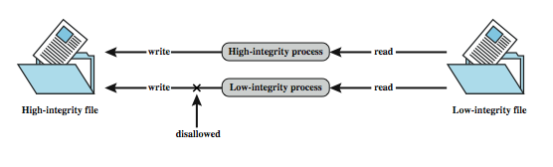
Biba Integrity Model
Various models dealing with integrity
Strict integrity policy:
Simple integrity: modify only if I(S) ≥ I(O)
Integrity confinement: read only if I(S) ≤ I(O)
Invocation property: invoke/comm only if I(S₁) ≥ I(S₂)
Notes:
16
The Biba [BIBA77] models deals with integrity, and is concerned with the unauthorized modification of data. The basic elements of the Biba model are like the BLP model. As with BLP, the Biba model deals with subjects and objects. Each subject and object is assigned an integrity level, denoted as I(S) and I(O) for subject S and object O, respectively. A simple hierarchical classification can be used, in which there is a strict ordering of levels from lowest to highest. Biba then proposes a number of alternative policies that can be imposed on this model. The most relevant is the strict integrity policy, based on the following rules:
• Simple integrity: A subject can modify an object only if the integrity level of the subject dominates the integrity level of the object: I(S) ≥ I(O).
• Integrity confinement: A subject can read on object only if the integrity level of the subject is dominated by the integrity level of the object: I(S) ≤ I(O).
• Invocation property: A subject can invoke another subject only if the integrity level of the 1st subject dominates the integrity level of the 2nd subject: I(S₁) ≥ I(S₂).
The simple integrity rule is the logical write-up restriction that prevents contamination of high-integrity data. Figure 10.4 illustrates the need for the integrity confinement rule. A low-integrity process may read low-integrity data but is prevented from contaminating a high-integrity file with that data by the simple integrity rule. If only this rule is in force, a high-integrity process could conceivably copy low-integrity data into a high-integrity file. Normally, one would trust a high-integrity process to not contaminate a high-integrity file, but an error in the code or a Trojan horse could result in such contamination. Hence the need for the integrity confinement rule.

Slide 17
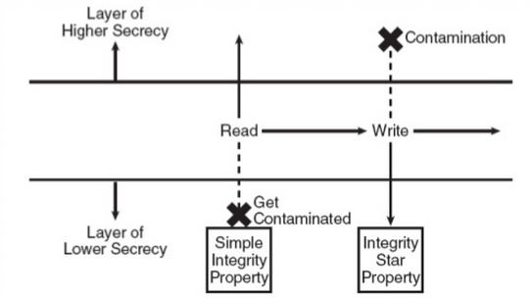
Biba Integrity Model
Simple integrity: modify only if I(S) ≥ I(O)
Integrity confinement: read only if I(S) ≤ I(O)
Invocation property: invoke/comm only if I(S₁) ≥ I(S₂)
Notes:
17
The Biba [BIBA77] models deals with integrity, and is concerned with the unauthorized modification of data. The basic elements of the Biba model are like the BLP model. As with BLP, the Biba model deals with subjects and objects. Each subject and object is assigned an integrity level, denoted as I(S) and I(O) for subject S and object O, respectively. A simple hierarchical classification can be used, in which there is a strict ordering of levels from lowest to highest. Biba then proposes a number of alternative policies that can be imposed on this model. The most relevant is the strict integrity policy, based on the following rules:
• Simple integrity: A subject can modify an object only if the integrity level of the subject dominates the integrity level of the object: I(S) ≥ I(O).
• Integrity confinement: A subject can read on object only if the integrity level of the subject is dominated by the integrity level of the object: I(S) ≤ I(O).
• Invocation property: A subject can invoke another subject only if the integrity level of the 1st subject dominates the integrity level of the 2nd subject: I(S₁) ≥ I(S₂).
The simple integrity rule is the logical write-up restriction that prevents contamination of high-integrity data. Figure 10.4 illustrates the need for the integrity confinement rule. A low-integrity process may read low-integrity data but is prevented from contaminating a high-integrity file with that data by the simple integrity rule. If only this rule is in force, a high-integrity process could conceivably copy low-integrity data into a high-integrity file. Normally, one would trust a high-integrity process to not contaminate a high-integrity file, but an error in the code or a Trojan horse could result in such contamination. Hence the need for the integrity confinement rule.

Slide 18
Clark-Wilson Integrity Model
Two concepts
Well-formed transactions: a user can manipulate data in constrained ways
Separation of duty: one can create a transaction but not execute it
CDI: constrained data items (loan app; checks)
UDI: unconstrained items
IVPs: procedures that assure all CDIs conform to integrity/consistency rules
TPs: transactions that change CDIs
Very practical; used in commercial world
Notes:
18
The Biba [BIBA77] models deals with integrity, and is concerned with the unauthorized modification of data. The basic elements of the Biba model are like the BLP model. As with BLP, the Biba model deals with subjects and objects. Each subject and object is assigned an integrity level, denoted as I(S) and I(O) for subject S and object O, respectively. A simple hierarchical classification can be used, in which there is a strict ordering of levels from lowest to highest. Biba then proposes a number of alternative policies that can be imposed on this model. The most relevant is the strict integrity policy, based on the following rules:
• Simple integrity: A subject can modify an object only if the integrity level of the subject dominates the integrity level of the object: I(S) ≥ I(O).
• Integrity confinement: A subject can read on object only if the integrity level of the subject is dominated by the integrity level of the object: I(S) ≤ I(O).
• Invocation property: A subject can invoke another subject only if the integrity level of the 1st subject dominates the integrity level of the 2nd subject: I(S₁) ≥ I(S₂).
The simple integrity rule is the logical write-up restriction that prevents contamination of high-integrity data. Figure 10.4 illustrates the need for the integrity confinement rule. A low-integrity process may read low-integrity data but is prevented from contaminating a high-integrity file with that data by the simple integrity rule. If only this rule is in force, a high-integrity process could conceivably copy low-integrity data into a high-integrity file. Normally, one would trust a high-integrity process to not contaminate a high-integrity file, but an error in the code or a Trojan horse could result in such contamination. Hence the need for the integrity confinement rule.

Slide 19
Certified and Enforcement Rules
C1: IVPs must ensure that all CDIs are in valid states
C2: All TPs must be certified (must take a CDI from a valid state to a valid final state)
(Tpi, CDIa, CDIb, CDIc, …)
E1: The system must maintain a list of relations specified in C2
E2: The system must maintain a list of (User, Tpi, (CDIa, CDIb, …))

Slide 20
Certified and Enforcement Rules
C3: The list of relations in E2 must be certified to meet separation of duties
E3 The system must authenticate each user when executing a TP
C4: All TPs must be certified
C5: Any TP that takes UDI as in input value must be certified to perform valid transaction
E4: Only the agent permitted to certify entitles is allowed to do so

Slide 21
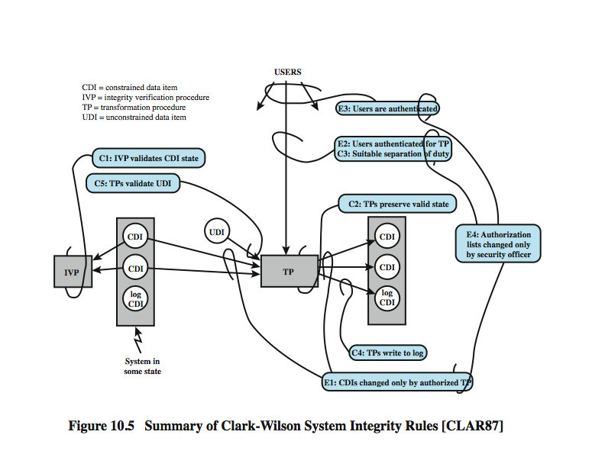
Clark-Wilson Integrity Model
Certification (C) and
Enforcement (E) rules
Notes:
21
A more elaborate and perhaps more practical integrity model was proposed by Clark and Wilson. The Clark-Wilson model (CWM) is aimed at commercial rather than military applications, and closely models real commercial operations. Figure 10.5 illustrates the rules in this model. The rules combine to form a two-part integrity assurance facility, in which certification is done by a security officer with respect to an integrity policy, and enforcement is done by the system. The rules are:
Cl: All IVPs must ensure all CDIs are in a valid state at the time the IVP is run.
C2: All TPs must be certified to be valid.
El: system must maintain a list of relations from C2, and must ensure manipulation of any CDI is by a TP,as specified in some relation.
E2: system must maintain a list of relations of the form: (UserID, TPi, (CDIa, CDIb, CDIc, . ..)), which relates a user, a TP, and data objects that TP may reference.
C3: list of relations in E2 must be certified to meet the separation of duty requirement.
E3: system must authenticate the identity of each user attempting to execute a TP.
C4: All TPs must be certified to write to an append-only CDI (the log) all info.
C5: Any TP that takes a UDI as an input value must be certified to perform only valid transformations, or else no transformations, for any possible value of the UDI.
E4: Only the agent permitted to certify entities may change the list of such entities associated with other entities.
See text for further details.

Slide 22
The Chinese Wall Model
Hybrid model: addresses integrity and confidentiality
Addresses conflict of interest (CI or CoI)
Model elements
subjects: active entities interested in accessing protected objects
information
objects: individual data items, each about a corp
datasets (DS): all objects concerning one corp
CI class: datasets whose corp are in competition (conflict of interest or CI)
access rules: rules for reading/writing data
Notes:
22
The Biba [BIBA77] models deals with integrity, and is concerned with the unauthorized modification of data. The basic elements of the Biba model are like the BLP model. As with BLP, the Biba model deals with subjects and objects. Each subject and object is assigned an integrity level, denoted as I(S) and I(O) for subject S and object O, respectively. A simple hierarchical classification can be used, in which there is a strict ordering of levels from lowest to highest. Biba then proposes a number of alternative policies that can be imposed on this model. The most relevant is the strict integrity policy, based on the following rules:
• Simple integrity: A subject can modify an object only if the integrity level of the subject dominates the integrity level of the object: I(S) ≥ I(O).
• Integrity confinement: A subject can read on object only if the integrity level of the subject is dominated by the integrity level of the object: I(S) ≤ I(O).
• Invocation property: A subject can invoke another subject only if the integrity level of the 1st subject dominates the integrity level of the 2nd subject: I(S₁) ≥ I(S₂).
The simple integrity rule is the logical write-up restriction that prevents contamination of high-integrity data. Figure 10.4 illustrates the need for the integrity confinement rule. A low-integrity process may read low-integrity data but is prevented from contaminating a high-integrity file with that data by the simple integrity rule. If only this rule is in force, a high-integrity process could conceivably copy low-integrity data into a high-integrity file. Normally, one would trust a high-integrity process to not contaminate a high-integrity file, but an error in the code or a Trojan horse could result in such contamination. Hence the need for the integrity confinement rule.

Slide 23
The Chinese Wall Model
Not a true multilevel secure model
the history of a subject’s access determines access control
Subjects are only allowed access to info that is not held to conflict with any other info they already possess
Once a subject accesses info from one dataset, a wall is set up to protect info in other datasets in the same CI
Notes:
23
The Biba [BIBA77] models deals with integrity, and is concerned with the unauthorized modification of data. The basic elements of the Biba model are like the BLP model. As with BLP, the Biba model deals with subjects and objects. Each subject and object is assigned an integrity level, denoted as I(S) and I(O) for subject S and object O, respectively. A simple hierarchical classification can be used, in which there is a strict ordering of levels from lowest to highest. Biba then proposes a number of alternative policies that can be imposed on this model. The most relevant is the strict integrity policy, based on the following rules:
• Simple integrity: A subject can modify an object only if the integrity level of the subject dominates the integrity level of the object: I(S) ≥ I(O).
• Integrity confinement: A subject can read on object only if the integrity level of the subject is dominated by the integrity level of the object: I(S) ≤ I(O).
• Invocation property: A subject can invoke another subject only if the integrity level of the 1st subject dominates the integrity level of the 2nd subject: I(S₁) ≥ I(S₂).
The simple integrity rule is the logical write-up restriction that prevents contamination of high-integrity data. Figure 10.4 illustrates the need for the integrity confinement rule. A low-integrity process may read low-integrity data but is prevented from contaminating a high-integrity file with that data by the simple integrity rule. If only this rule is in force, a high-integrity process could conceivably copy low-integrity data into a high-integrity file. Normally, one would trust a high-integrity process to not contaminate a high-integrity file, but an error in the code or a Trojan horse could result in such contamination. Hence the need for the integrity confinement rule.

Slide 24
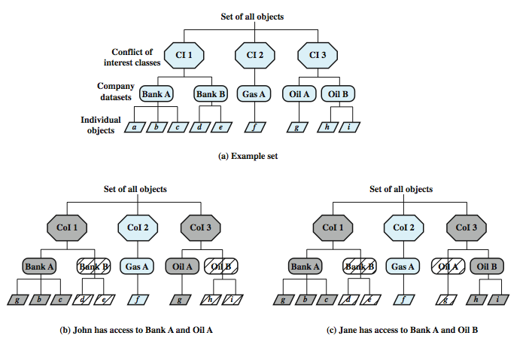
Chinese Wall Model
Simple sec rule (read): S can
read O if O is in the same DS as
an object already accessed by S
OR O belongs to a CoI from which
S has not yet accessed any info
*-property (write): S can write
O only if S can read O and all objects
that S can read are in the same DS
as O.
Question: what can John or
Jane write to?
Notes:
24
The Chinese Wall Model (CWM) takes a quite different approach to specifying integrity and confidentiality than any of the approaches we have examined so far. The model was developed for commercial applications in which conflicts of interest can arise. The principal idea behind the CWM is the use of a Chinese wall to prevent a conflict of interest. Figure 10.6a gives an example. There are datasets representing banks, oil companies, and gas companies. All bank datasets are in one CI, all oil company datasets in another CI, and so forth. In contrast to the models we have studies so far, the history of a subject's previous access determines access control. The basis of the Chinese wall policy is that subjects are only allowed access to information that is not held to conflict with any other information that they already possess. Once a subject accesses information from one dataset, a wall is set up to protect information in other datasets in the same CI. The subject can access information on one side of the wall but not the other side. Further, information in other CIs is initially not considered to be on one side or the other of the wall but out in the open. When additional accesses are made in other CIs by the same subject, the shape of the wall changes to maintain the desired protection. Further, each subject is controlled by his or her own wall - the walls for different subjects are different. To enforce this, two rules are needed:
Simple security rule: A subject S can read on object O only if: O is in the same DS as an object already accessed by S, or O belongs to a CI from which S has not yet accessed any information. Figure 10.6b and c illustrate the operation of this rule.
*-property rule: A subject S can write an object O only if: S can read O according to the simple security rule, and All objects that S can read are in the same DS as O. Thus, in Figure 10.6, neither John nor Jane has write access to any objects.

Slide 25
Compare CW to Bell-LaPadula
CW is based on access history, BLP is history-less
BLP can capture CW state at any time, but cannot track changes over time
BLP security levels would need to be updated each time an access is allowed
Notes:
25

